Slide 1

Orange Money
Subscriber Self Subscription
Using Maxit App
Date: July 2025

Slide 2
Context
Context
Market
Orange Liberia is a main actor on the market and strong number 2 on Mobile Money
Population for Liberia at at July 2025 is more than 5.7million persons(worldometer), Orange counts XXX million telco customers and 4million on the OM solution, XXm 90 days active, 1.1m 30 days active
The main players in the telecom sector include two private GSM mobile network operators, Lonestar Cell MTN and Orange Liberia (formerly Cellcom), and the Ministry of Posts and Telecommunications (MPT) and LIBTELCO
Orange Money Liberia counts 1.1m 30days active users with xxx active user on the Maxit app solution
As at July 2025, OM has about 800k subs active on GSM but not on OML
Smart {Phoen penrtration XXX, Liberi, OMLXXX
Challenge
-
Towards a new digital and innovative solution
Think a new digital solution for all the customers ( with and without an Orange SIM card)
Simplify the access with the self registration to increase the uptake of digital financial solutions.
Push the curent USSD users to upgrade to the digital solution where Customer Journey is friendly and easy to interact with.
OM posoistion itself to take advantage of Interoperability roll out in August 2025 by the CBL

Slide 3
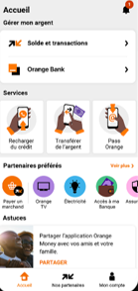
Current Vs New Approach
Context
Current situation
New approch
Subscriber registration is done only via registration agents using a custom KYA app.
Registration requires having registration agents in all major settlements in the country and this has high costs and logistics.
In rural areas, the subscriber might need to travel to a nearby town to get registered.
The subscriber does not need to leave the comfort of their homes. They simply download the Maxit App and fill in the registration form.
The Maxit App is available to all no mater the network.

Slide 4
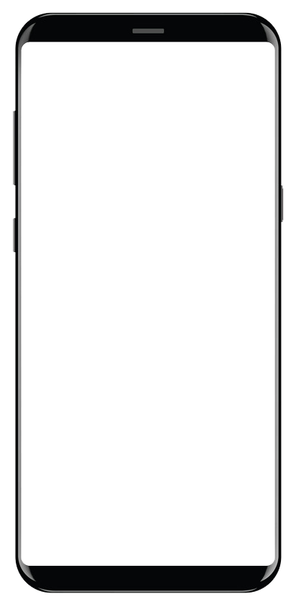
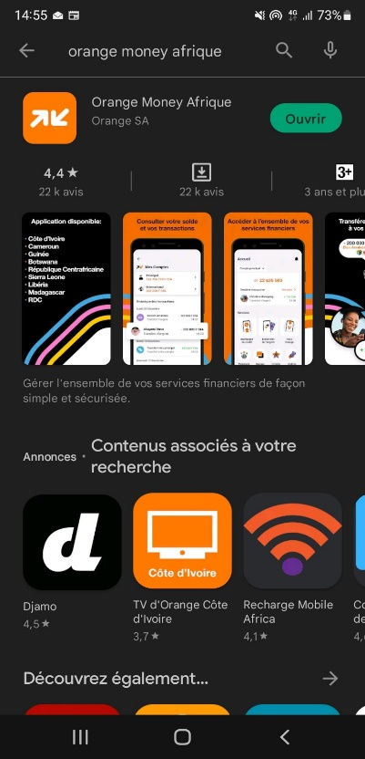
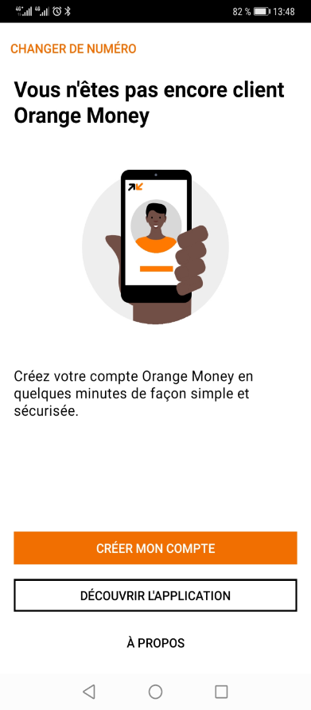



| User journey self subscription on Maxit
Change number
Step 1
Fill the form below
First name
IEnter your first name ________
Last name
Enter your last name___________
Date of birth
Enter the date of birth__________
Gender
Male Female
Occupation
Select your proffetion__________
ID card No.
Enter your ID card number______
Nationality
Select your country of origin_____
Address:
Enter your addres_____________
Email:
Enter your email (optional)______
Step 2
Choose type of ID
Select the type of ID______
Take picture of your ID or other documents if needed
Step 3
Take picture of your face
Step 4
Review your details
You are not yet an Orange Money customer
First name: James
Last name: Smith
Date of birth: 02/09/1990
Gender: Male
Occupation: Teacher
ID card No.: 24356783
Nationality: Liberian
Address: 13th Street Sinkor,
Monrovia
Email: N/A
Create your Orange Money account in a few minutes simple and secure
Create my account
Verify the quality of the picture. If the informations are unreadable, please try again
Verify the quality of the picture and make sure you take from your shoulders.
Discover the application
Change your details
About us
Continue
Continue
Continue
Validate
If ID Type = National ID then Take front and Back images (additional page)
Back Camera opened

Slide 5


| User journey self subscription on Maxit
Step 5
Review & accept Orange Money Terms & Conditions
1. PURPOSE
Orange Money Service Terms and Conditions govern the access and use of Orange Money Services offered by Orange Money via mobile phones to holders of Orange Money Accounts (the “OM Service”). The signing of this Application Form and activation of the Orange Money Account by the Customer shall constitute acceptance of all terms and conditions as herein contained.
2. DEFINITIONS
In these terms and conditions the following terms shall have the following meaning as set forth herein below:
Step 6
Signature of contract
Step 7
Your subscription request has been taken into account, you will receive the details by sms
Validation code
Input the secret code received by SMS
Accept
Validate

Slide 6
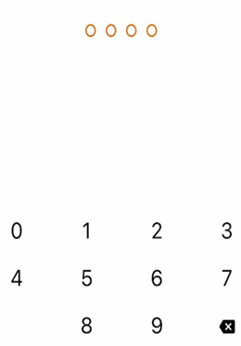
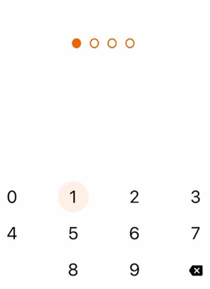
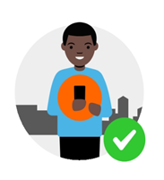
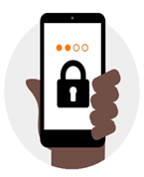
| User journey self subscription on Maxit
Last step! Create your secret code
You will use this secret code to get connected to the application
Congratulations, your are now an Orange Money customer
You can now use your Orange Money account
Create your secret code
Validate your secret code
Continue
Validate
Validate
Close

Slide 7
FAQ
Question | Answer
What is Orange Money self-subscription | Is a solution that allows existing Orange telco customers or Non-Orange customer to subscribe to Orange Money account themselves through the Orange Maxit app.
How is this done | By downloading the Orange Maxit App via Apple App store or google play store. The app will detect you are not registered and offer the option to self register.
What are the prerequisites to benefit from this service | Have a smartphone, download and install the Maxit App
What are the target of OM self-subscription | Orange Customer Non-Orange Customer (MTN Customer)
Is this service charged | No, the service is free of charge for both Orange customers and Non-Orange customer (MTN etc.)
Can a Non Orange customer perform OM operations | The customer will be able to use Orange Money services (Deposit, Withdrawal, P2P, Merchant Payment) excluding Buying Airtime and Bundles which are telco specific, we modify after interoperability roll out
Can the Non-Orange customer purchase airtime for themselves on their MTN number | No, non Orange customer cannot purchase airtime.
Can Non-Orange customer access *144# via (USSD) | No, all Non-Orange customers operations are only done via Maxit app
Does the OM customer have the possibility to make a modification/regularization of his KYC/uncapping on the app | No, modifications, regularizations, uncapping, the customer goes to Orange Offices or Orange POS stations
Are the rate/fees/charges same for Orange and non-Orange customers? | Yes: the prices are the same for everyone

Slide 8

Thank you

